Slide 1
Was America fighting
a "Just War"?

Slide 2

What is a just war?
A just war is that:-
A good intention should be behind it
It should be a last resort
There must be a chance of success
How should a just war be fought:-
-innocent people should not be harmed
Only appropriate force should be used
Internationally agreed conventions regulating war must be obeyed

Slide 3
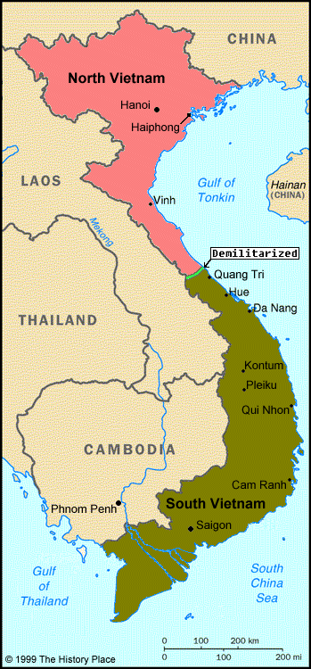
Introduction
The Vietnam war occurred in Vietnam. Laos and Cambodia during 1959 and 30 april1975. the war started when communist north Vietnam tried to take over the republic of south Vietnam. It was the longest war America ad ever fought in and it lasted 15 years.
North Vietnam wanted to take over South Vietnam. If they succeeded then it’ll be likely that Laos and Cambodia will turn Communist.
Laos and Cambodia might’ve turned Communist because they are so vulnerable

Slide 4
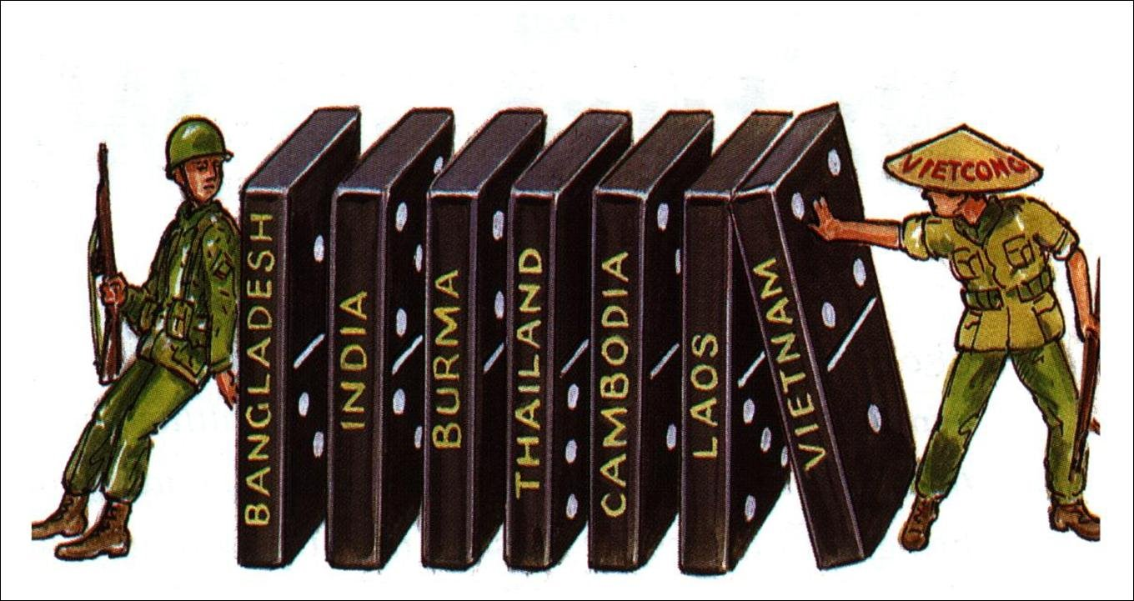
Domino Theory
The Domino Theory was that if North Vietnam won the war then Laos Cambodia and the rest of Asia will turn communist. America and south Vietnam did not wan to be communist and let it spread throughout Asia.

Slide 5
FOR & AGAINST OF THE WAR
FOR:-
it’ll help South Vietnam
justice may be brought
There wont be any communism
The Domino Theory was that if south Vietnam became communist then all the other Asian countries will become against.
The Americans had more weapons, machine guns, rockets, launchers, tanks and helicopters.
The war established peace and stability.
AGAINST:-
Vietnam could fight for themselves
The U.S used napalm which killed 400 000 innocent civilians
No one in America supported the war as it used unnecessary force which massacred the whole village
William Kaylie was responsible for the killing of loads of civilians. He was imprisoned for life.
most of South Vietnam didn't support the U.S
Many Americans staged anti-war protest

Slide 6
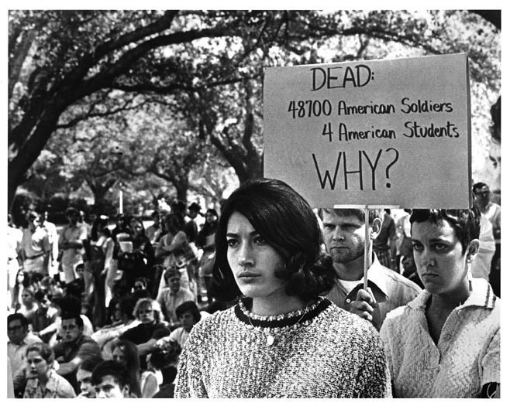
What was happening to U.S
during the war?
Hippie movement started on December 31st .During the 1960’s 250 000 anti-war protestors gathered in Washington D.C. It was the largest protest to occur during the Vietnam war. Many Americans where against the war in Vietnam mainly because 48 100 American soldiers died including 4 Students. They did not like the idea that America got involved in the Vietnam War. Thousands and Thousands of deaths occurred. Too many people died.

Slide 7
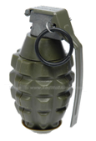
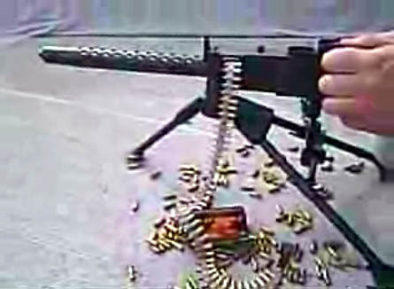
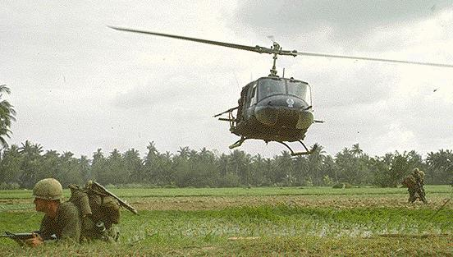
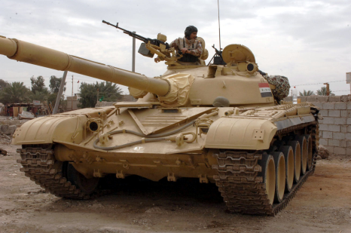
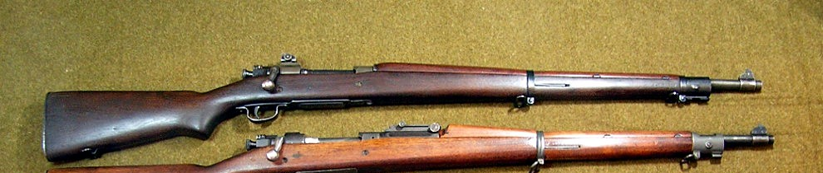
What Weapons were used?
Most of the Weapons used were:
Grenades
Rifles
Rocket launcher
Machine guns
Napalm
Tanks
ETC

Slide 8
Was there a chance of success?
FOR:-
American troops in Vietnam had vastly superior weapons than the Vietcong. American soldiers had machine guns and were supported by tanks and helicopters. They had napalm which was a type of petroleum jelly which burns the skin. The Americans used this to burn down all of the jungles and see where the guerrillas were hiding.
Against:-
America couldn't find the guerrillas because they were really good at blending inn with everyone. The Americans couldn’t tell if they guerrillas were normally civilians. They were always ready to ambush them. Also the people in south Vietnam would not tell the American troops were the guerrillas were hiding.

Slide 9
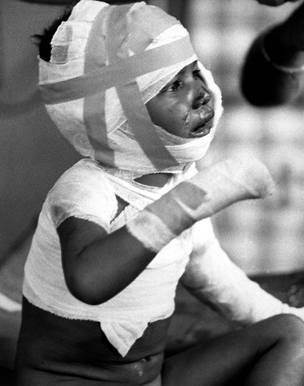
What are the effects of the Vietnam War?
The Vietnam War caused the breakdown of many families and also a breakdown of the Vietnamese culture. Thousands upon thousands of children were orphaned during the war and ended up either in orphanages or on the streets without a home.
Napalm was used and it caused a mass number of damage to the plants and the jungles itself.
Napalm also caused damage to the skin and it burned many innocent people during the war.

Slide 10
Deaths During the War

Slide 11
How did the War end?
March 29, 1973
Vietnam War Officially Ends
The Vietnam War is officially over for the United States. The last U.S. combat soldier leaves Vietnam, but military advisors and some Marines remain. Over 3 million Americans have served in the war, nearly 60,000 are dead, some 150,000 are wounded, and at least 1,000 are missing in action. The military advisors left south Vietnam in 1975 after training the south Vietnamese to defend themselves and agreeing to a cease fire.
President Gerald Ford, who replaced Nixon, was shown a video in which South Vietnam soldiers mobbed a plane intended to evacuate children.
He said: 'That's it. We're pulling the plug on Vietnam’.

Slide 12
My Conclusion
In conclusion I believe that the war was just and not because of the following reasons. The War in Vietnam was Just because Vietnam needed help and they didn't have a lot of good troops unlike the U.S. South Vietnam did not have extremely good weapons like the Americans did. America did not want South Vietnam to be communist. They also fought in the war to help prevent the spread of communism (domino Theory see slide 5). However I also think that it was not just because South Vietnam could fight for themselves the government wanted the help of America however the civilians did not want there help. America killed 1, 170, 000 civilians were injured. This shows that they did more injuries than help. They also lost 58,000 U.S troops. Many people say that it is a waste of time and lives. For the Vietnamese maybe it was just however other countries such as china and United states.

Slide 13

By Haleema Khan 9G

Slide 14


